Slide 1

SORTING

Slide 2
SESSION OVERVIEW:
DEFINITION
TYPES
Bubble Sort
Selection Sort
Insertion Sort

Slide 3
DEFINITION
An Algorithm Used to Arrange all the elements in the List in a Particular Order
Ascending or Descending

Slide 4
TYPES
Selection Sort
Insertion Sort
Merge Sort
Heap Sort
QuickSort
Radix Sort
Counting Sort
Bucket Sort
ShellSort
Bubble Sort

Slide 5
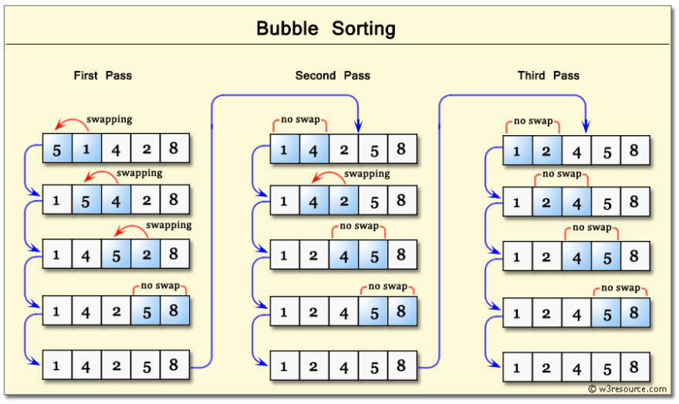
BUBBLE SORT

Slide 6
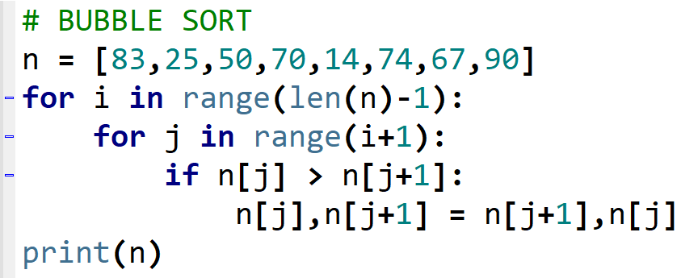


Slide 7
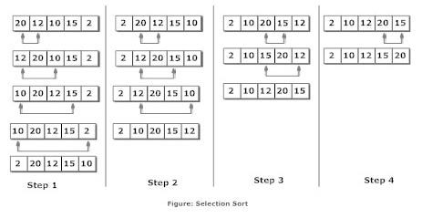
SELECTION SORT

Slide 8
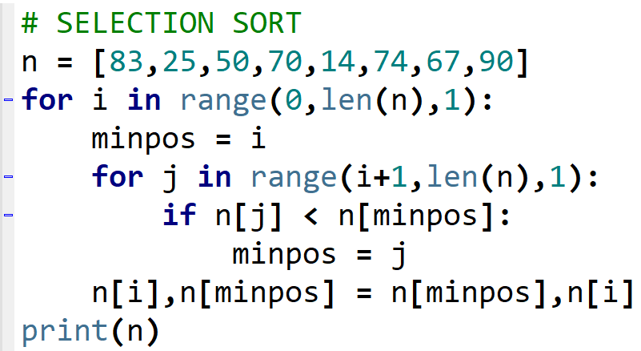


Slide 9
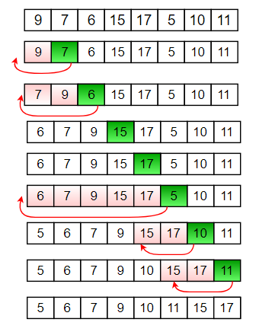
INSERTION SORT

Slide 10
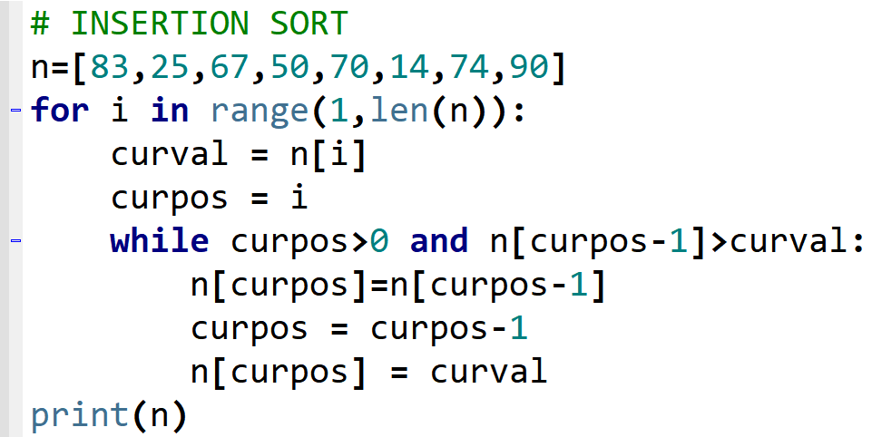


Slide 11

CODING IS FUN ! THANK YOU !!

